Slide 1
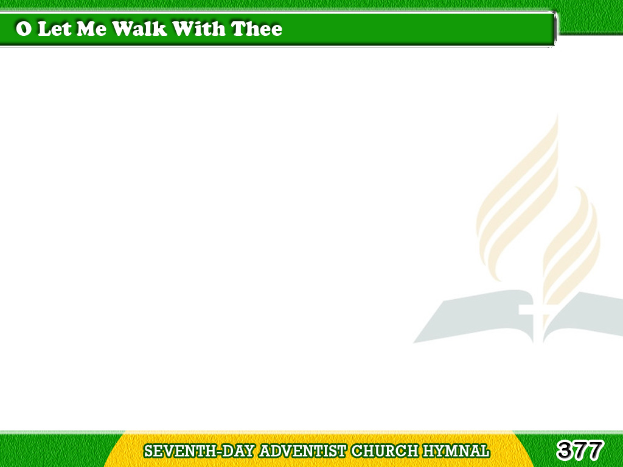
1/3
O let me walk with Thee, my God,
As Enoch walked in days of old;
Place Thou my trembling
hand in Thine,
Tagalog
Version

Slide 2
1/3
And sweet communion
with me hold;
E’en though the path
I may not see,
Yet, Jesus, let me walk with Thee.
Tagalog
Version

Slide 3
2/3
I cannot, dare not, walk alone;
The tempest rages in the sky,
A thousand snares beset my feet,
Tagalog
Version

Slide 4
2/3
A thousand foes are lurking nigh.
Still Thou the raging of the sea,
O Master! let me walk with Thee.
Tagalog
Version

Slide 5
3/3
If I may rest my hand in Thine,
I’ll count the joys
of earth but loss,
And firmly, bravely journey on;
Tagalog
Version

Slide 6
3/3
I’ll bear the banner of the cross
Till Zion’s glorious gates I see;
Yet, Savior, let me walk
with Thee.
Tagalog
Version

